Slide 1
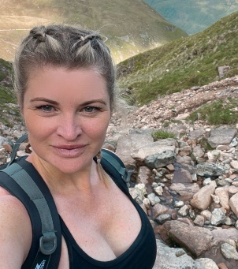
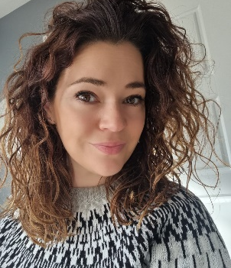
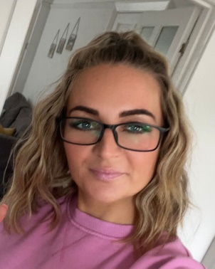
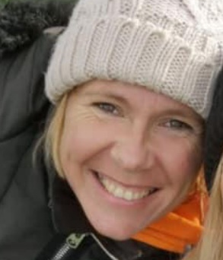
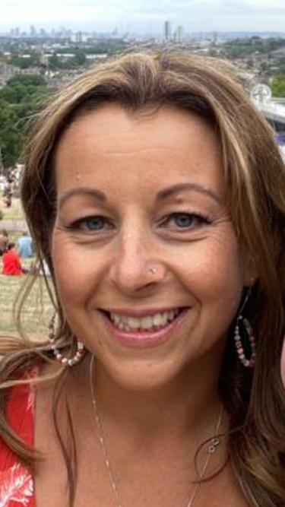
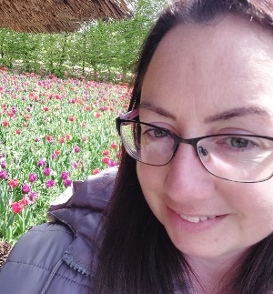
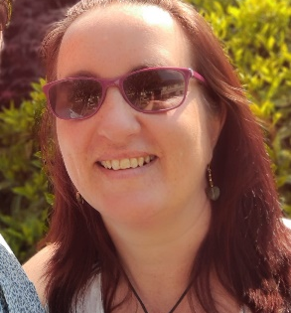
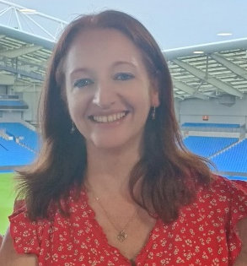
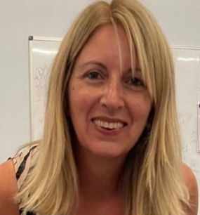
Co-Chairs
Rachael Seymour & Clara Thomson
Treasurers
Hannah Kelly & Rose Nelson
Networker & Publicity Officer
Clara Thomson
School Liaison
Sonia Hunter
Sponsorship & Raffle Coordinator
Katy Robinson
General Committee Members
Kate Marchant, Hayley McCabe, Gemma Wells, Jackie Defee, Pam Stewart, Sarah Mackley
Secretary
Shared between several committee members
Who are Friends Of West Park School PTA?
Friends of West Park are West Park School’s Parent-Teacher Association (or PTA) as well as a registered charity. We are a committee of parents, joined together with a common aim of organising events and raising money for the good of our school, the teachers and the children in it.
We are always looking for more volunteers to join the committee so please do get in touch if you’d like to offer your support or to find out more information- westparkcofepta@gmail.com
Westparkcofepta@gmail.com
@Friendsofwestpark
@FOWPSchool

Slide 2
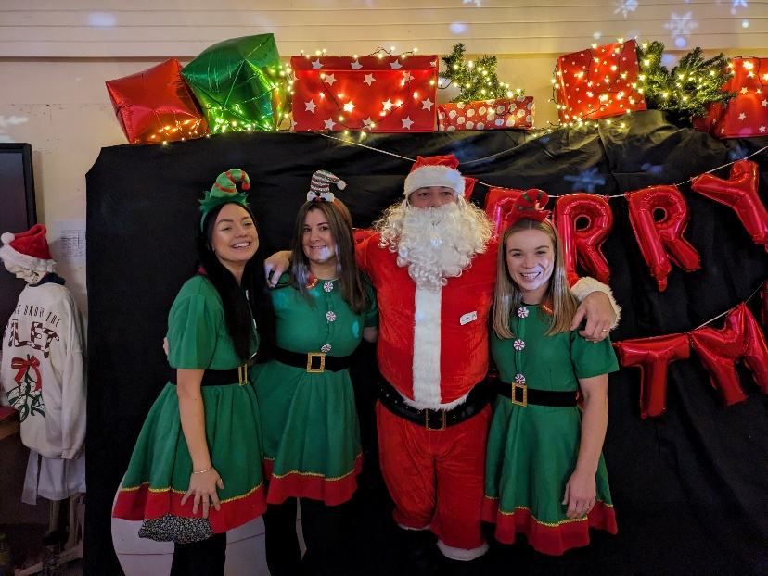
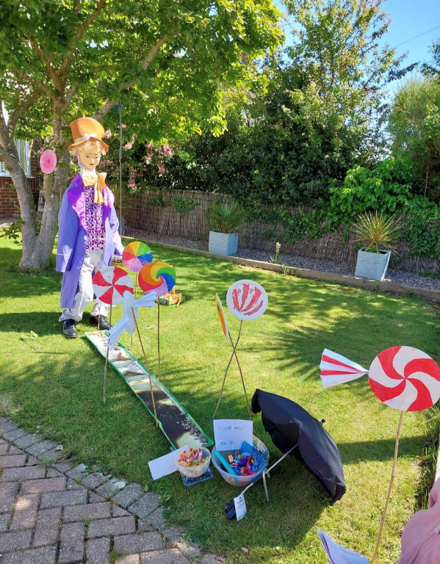
What do FOWP do for our School?
Friends of West Park organise and run activities and events to raise much needed money for our school. We have raised over £51,000 in the last 5 years!
Since the start of the new academic year (Sept 2023) till now, we have raised in excess of £26,000 (Including grants)
Some of the events and activities that we have organised include Christmas Cards, Pantomime, Christmas Raffle, Scarecrow Trail, Bake Sale, Pre-loved uniform sale, pancake-flip-a-thon, Christmas Fayre, Summer Fayre, Discos and Outdoor Cinema evening
Westparkcofepta@gmail.com
Follow us on
Social Media
@Friendsofwestpark
@FOWPSchool

Slide 3
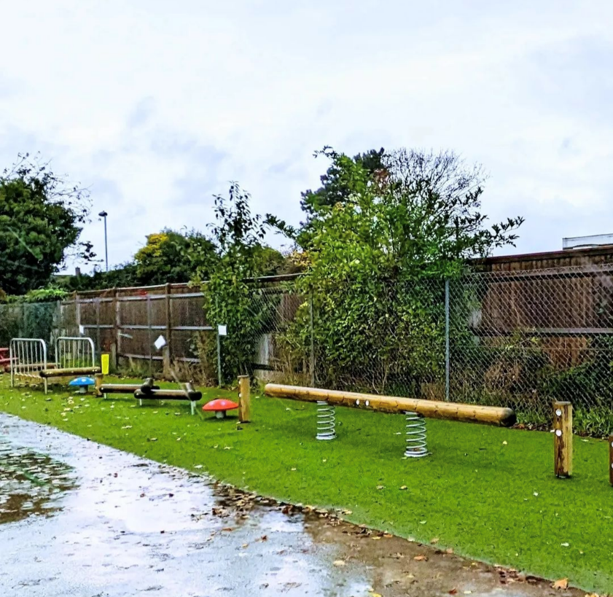
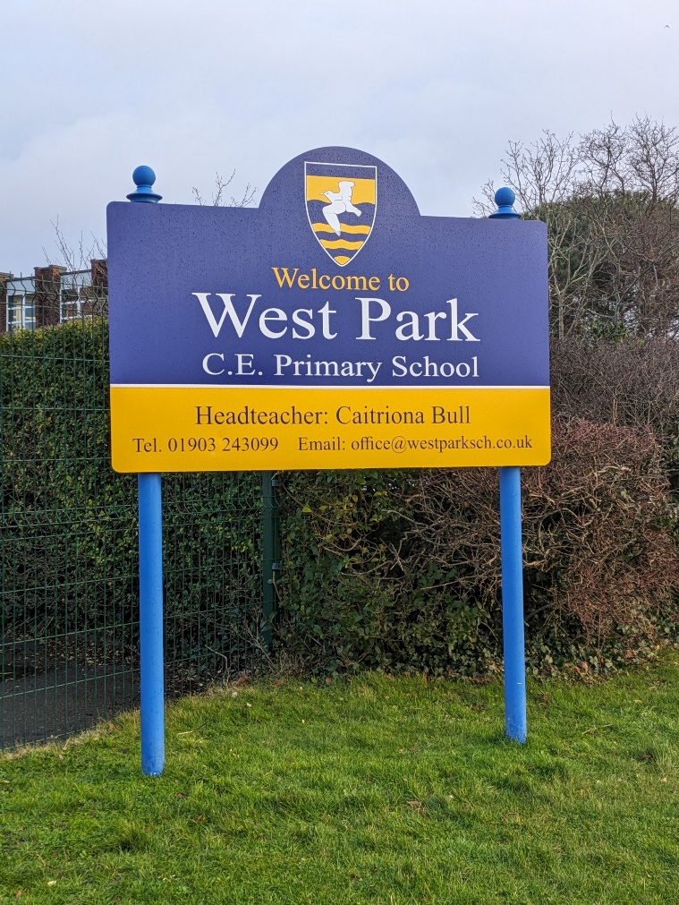
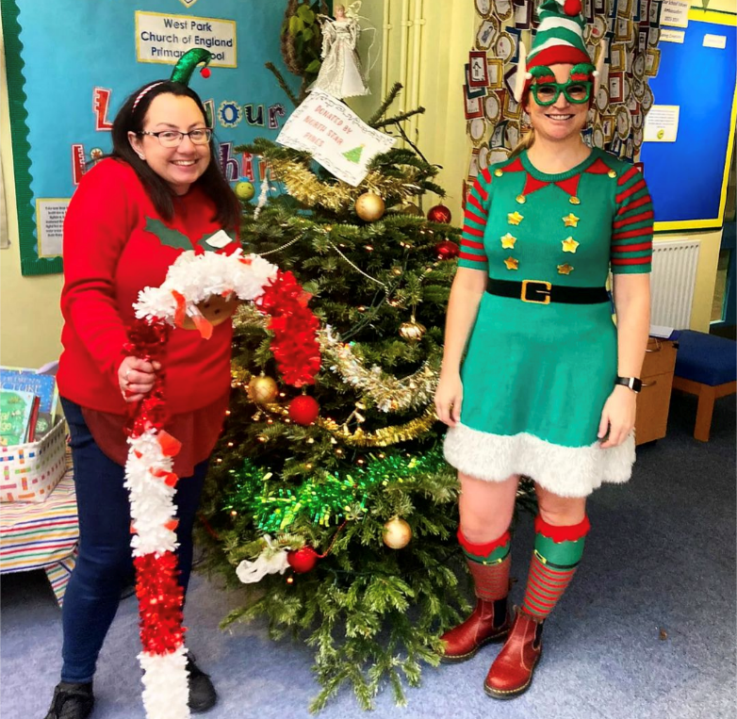
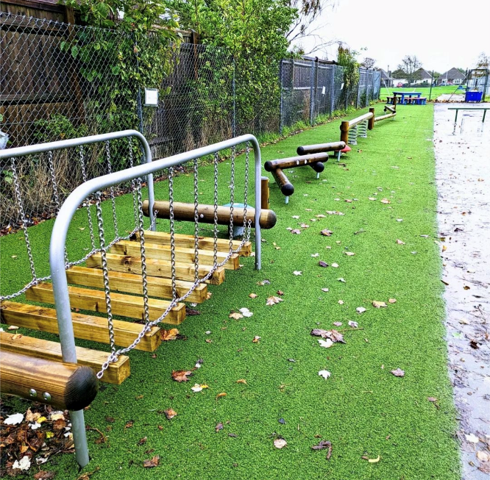
How does the money FOWP raise benefit our School?
Here are a few of the ways our school has benefitted from the money that we have raised-
The school library was transformed form a tiny space to a much larger spaced filled with lots of new books
-Key Stage 2 have unlimited access to TT Rockstars, which is a valuable and popular maths resource
-We have installed two brand new Trim Trails for Key Stage 1 and Key Stage 2
-We have donated £2,500 towards a new school website
-We have secured a £10,000 grant to build an outside hub
-We have donated to new school signs
-New maths equipment, wet play games, a new hutch for the schools Guinea Pigs, as well as a book for every child at Christmas delivered by Santa’s Elves.
Westparkcofepta@gmail.com
Follow us on
Social Media
@Friendsofwestpark
@FOWPSchool

Slide 4
By using the clothes recycling bin outside the front of the school 40p for every kilo and £400 per tonne of clothes will be donated to the school.
Recycle your clothes, save the planet and donate to the school!
Why Should I Join The PTA?
It might be hard work at times, but seeing the excitement on the children's faces as they lined up to take a turn on the trim trail, or watching their delight at the fayre or event you put your dedication and soul into organising, certainly gives a little glow in the heart! We do it for the children. So that their time at West Park can be the most enriched and enjoyable as possible.
How Can you support FOWP and the School?
Everyone is welcome to attend our termly PTA meetings where we discuss and organise upcoming events and new ideas.
If you would like to help, we are grateful for any time volunteered. The FOWP committee is made up of busy parents who all have jobs/run businesses and children at the school, we understand time is precious and limited, but any help you can offer is most welcome! We have a Volunteer WhatsApp group you can join to keep up to date with upcoming events.
What if I don't have any free time?
There are so many ways you can still help without giving up your time!
-Ask your company/employer if they offer matched funding, or if they would be willing to be a sponsor of our events.
-Are you a small business owner? A baker/hairdresser/ beautician/ window cleaner etc. you could offer your services as a raffle prize!
-You can make a one off or regular donation to FOWP which will go directly to enriching the experiences of the pupils of our school
We have also signed up to Kids Just Recyle, Stikins and the Giving Machine which provide easy ways for you to support us and the school.
These are some of little ways you can help raise money for the school…
Register at https://www.thegivingmachine.co.uk/causes/friends-of-west-park-school and shop with over 2000 of your favourite shops as normal through this app and each shop donates to FOWP!
Shop here at www.stikins.co.uk for your children’s name labels. Place an order and quote ref 24877 and the school will earn 30% commission!
Westparkcofepta@gmail.com
@Friendsofwestpark
@FOWPSchool

